Slide 1
Modules 7 Overview Computer Communications
All Images are taken directly from the Davis Electromechanical Systems eBook except those with links below the pictures.
Read the book for additional information and examples.
* You are responsible for knowing everything in the book for Quizzes and Exams.

Slide 2
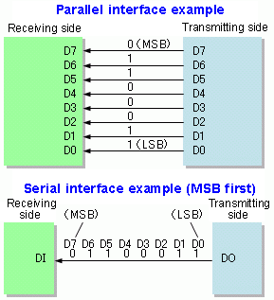
Parallel and Serial Communication Bit Transmission

Slide 3
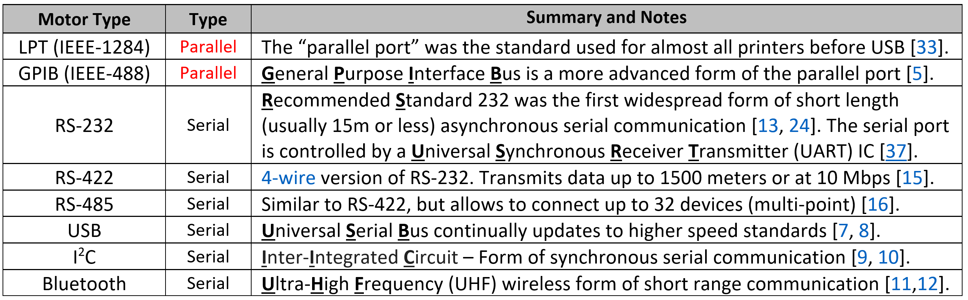
Computer Communication Examples
Note on 2-wire versus 4-wire: The 2-wire RS-232 serial protocol is an example of single-ended data transmission and the 4-wire RS-422 or RS-485 serial protocols are examples of double-ended (or differential) data transmission. Differential configuration allows noise or any signal that is common to both input lines to be canceled out.

Slide 4
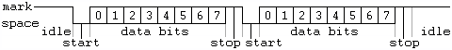
RS-232 Example of Asynchronous Serial Communication
RS-232 is an example of asynchronous communication, where the data are NOT transmitted by a clock signal, as done in synchronous communication. Without a clock, special signaling schemes (i.e. start and stop bits) are used to help the sender and receive communicate with each other. This adds additional complexity and the overhead by adding extra bit results in less data transmitted in a given time (i.e. less throughput)
Binary 0 (called a space): Transmitted signal +5 to +15 V_{DC}, Received Signal: +3 to +13 V_{DC}
Binary 1 (called a mark): Transmitted signal -5 to -15 V_{DC}, Received Signal: -3 to -13 V_{DC}
In addition to the start and stop signaling bits, a parity bit that is frequently added to the RS-232 bit stream. Parity is a rudimentary form of error checking that is frequently used in RS-232.

Slide 5
Example 7.1) If there are 8 data bits, 1 start bit, 2 stop bits, and 1 parity bit then each time 8 bits of data (i.e. 1 byte) were transmitted how much longer would it take? This can also be called the %overhead.
Solution) The overhead includes 1 start bit, 2 stop bits, and 1 parity bit → 4 bits of overhead.
12 bits are transmitted instead of 8 so the transmission time increases by:
(12-8)/8 = 50%. %overhead = 50%.

Slide 6
Transmission Speed (Baud)
Note: When transmitting a file
1 kB = 2e10 Bytes = 1,024 Bytes
1 MB = 2e20 Bytes = 1,048,576 Bytes
1 GB = 2e30 Bytes = 1,073,741,824 Bytes
1 TB = 2e40 Bytes = 1,099,511,627,776 Bytes
Example 7.8) Calculate the %overhead and The number of minutes it takes to transmit 5 MB of data using the following RS-232 communication parameters.
Baud Rate = 115.2 kbps or 115,200 bps (Note: 1 kbps = 1000 bps)
Data Bits = 5
Parity = odd
Start Bits = 1 (Note: you always have 1 start bit)
Stop Bits = 2
Each data frame has 5 data bits and 4 overhead bits. → %overhead = 4/5 = 80%
Total number of data bits = 5MB*(2e20 Bytes/MB)*(8 Bits/Byte) = 41,943,040 bits
Taking into account the overhead bits the total number of bits to be transmitted
Total bits = 41,943,040 bits * (1 + %overhead) = 41,943,040 bits * 1.8 = 75,497,472 bits
Total time = 75,497,472 bits/115,200 bits per second = 655.36 seconds = 655.36/60 = 10.92 minutes

Slide 7
Parity
If a parity bit is allocated and used for error checking, then either odd or even parity is used to set the parity bit:
Odd – The parity bit is set so that the total number of ones in the data bits & parity bit is odd.
Even – The parity bit is set so that the total number of ones in the data bits & parity bit is even.
If a parity bit is allocated, but NOT used for error checking, then either mark or space is used to set the parity bit:
Mark – The parity bit is always set to 1.
Space – The parity bit is always set to 0.

Slide 8
Example 7.2) If the following bytes of information (given in hexadecimal) are transmitted 8 bits at a time and odd parity is used, determine the value of the parity bit for each byte. Data → E3 9A
Solution)
E3 = 1110 0011 → There are 5 ones in E3. Since it is already an odd number, the parity bit is 0.
9A = 1001 1010 → There are 4 ones in 9A. Since it is an even number of ones, the parity bit is 1 to make it an odd number of ones.
Example 7.3) If the following bytes of information (given in hexadecimal) are transmitted 8 bits at a time and even parity is used, determine the value of the parity bit for each byte. Data → FD 36
Solution)
FD = 1111 1101 → There are 7 ones in FD. Since it is an odd number of ones, the parity bit is 1 to make it an even number of ones.
36 = 0011 0110 → There are 4 ones in 36. Since it is already an even number, the parity bit is 0.

Slide 9
Example 7.6) The ASCII character E is transmitted with RS-232 using 7 data bits, odd parity, 1 start bit, and 2 stop bits.
A) Write the bit stream out assuming the data moves from right to left from the sender to receiver with the form: [Start Bit][Parity Bit][Data Bits][Stop Bits]
E = (45)₁₆ (100 0101)₂
[0][0][100 0101][11]
There are 4 overhead bits and 7 data bits so the % overhead = (11-7)/7 = 57.1%
B) Also, calculate the %overhead for this transmission?
C) If the middle bit of the 7 bit ASCII character is flipped during transmission will the parity error checking detect the bit error?
The receiver receives 100 1101. The parity bit would be determined by the receiver to be 1 because there are 4 ones in the data bits. Since the parity bits from the sender and receiver don’t agree then the receiver detects an error in the transmission.
D) If the first and last bit of the 7 bit ASCII character is flipped during transmission will the parity error checking detect the bit error? PARITY ONLY DETECTS AN ODD # of BIT ERRORS
The receiver receives 000 0100. The parity bit would be determined by the receiver to be 0 because there are 1 one in the data bits. Since the parity bits from the sender and receiver agree then the receiver doesn’t detect an error in the transmission.

Slide 10
Error Detection and Correction
There are many more sophisticated error detection algorithms that can be used to detect any type of bit error. Two of the more popular methods are [26]:
Hamming Codes add additional overhead by using multiple parity bits, but can detect all bit errors and in some situations correct bit errors. It must be implement on a fixed number of data bits.
Cyclic Redundancy Check (CRC) runs a block of data of any size through a mathematical algorithm called a polynomial and the result of the polynomial (sometimes referred to as a checksum) is transmitted along with the data. When the receiver gets the data, it can be sent through the same polynomial to see if the same results are obtained. With CRC no error correction can be made.

Slide 11
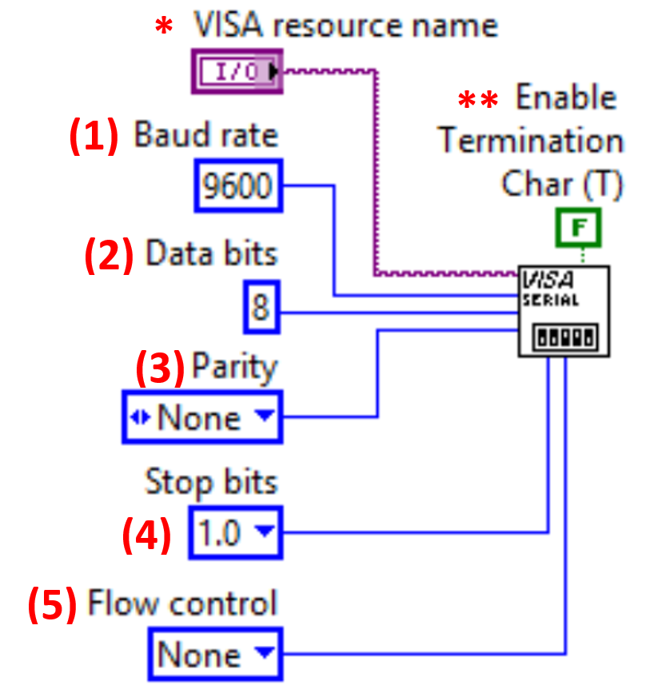
Configuring a Serial Port in LabVIEW
Baud Rate is a metric for transmission speed and is given in units of bits per second (bps). The default in LabVIEW is 9600 bps.
Data Bits – Figure 7.2 shows the number of data bits is 8 (bits 0 to 7), which is the default number of data bits value used in LabVIEW.
Parity – The default setting in LabVIEW is for no parity to be used (i.e. None), but if parity is implemented then usually Odd parity or Even parity are used, but there is also the option of mark or space.
Stop Bits – As shown in Figure 7.2 the logic level returns to a logic high (1) after the data is transmitted. The default is 1 stop bit, but LabVIEW allows 1.5 and 2 as other options. Start bits are also used, but there is always one start bit so there is no reason for it to be configurable. Together, the Start and Stop bits are often called “framing bits” that add additional overhead.
Flow Control (Also called handshaking) – RS-232 can employ a back and forth protocol to govern the data transfer process. The most common method is the Ready to Send (RTS), Clear to Send (CTS) flow control method. In RTS/CTS, the sender asserts the RTS line low to tell the receiver it is ready to send the data, and then the receiver asserts the CTS line low to tell the sender it is ready to receive the data [21, 23, 24].

Slide 12
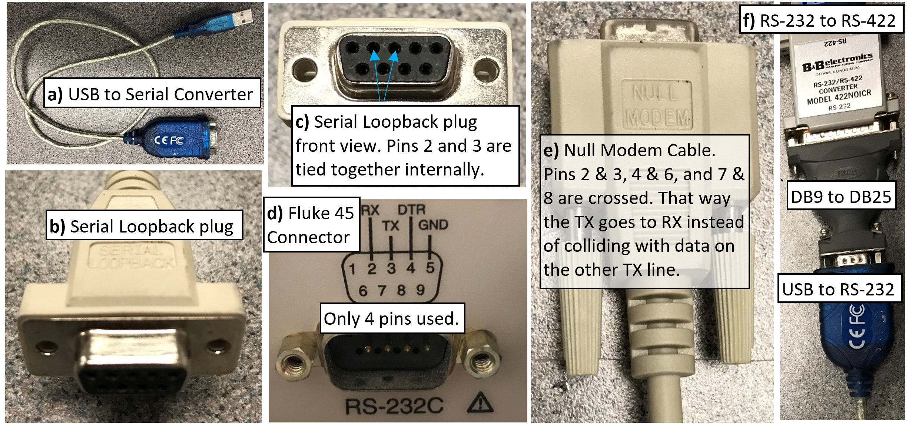
Communicating with a Serial Instrument in LabVIEW

Slide 13
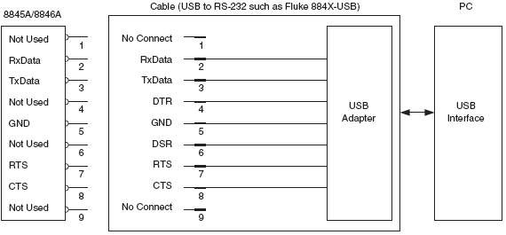
RS-232 – USB Adapter Pin Out

Slide 14
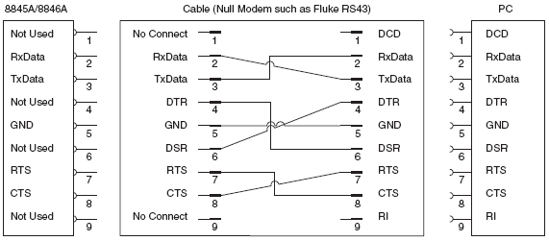
RS-232 – Null Modem Pin Out

Slide 15
5 Steps of Serial Communication
After connecting to the device with a properly functioning serial port the following steps must be taken to communicate with the device in LabVIEW (or another program such as Matlab [21]).
Initialization – Make sure the 5 parameters in Figure 7.3 are set to the same parameters on both devices.
Write a command – The programming guide of the device will provide the message structure for writing.
Wait – There is a delay in how long it takes the device to respond (i.e. Baud rate). Wait extra time to be safe.
Read from the device – The programming guide will provide the message structure of the received data.
Parse – The received data isn’t very useful without using the LabVIEW string palette to parse the message.

Slide 16
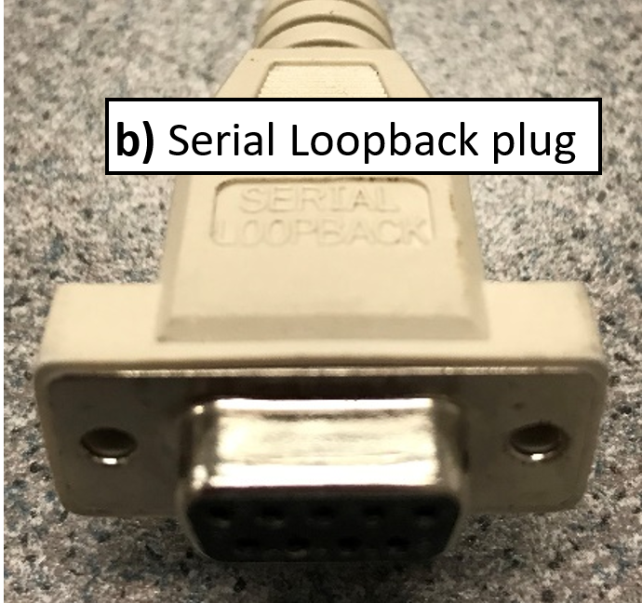
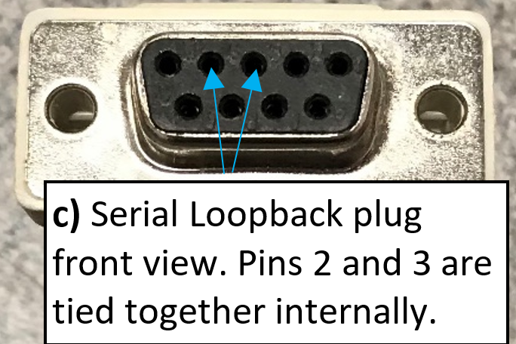
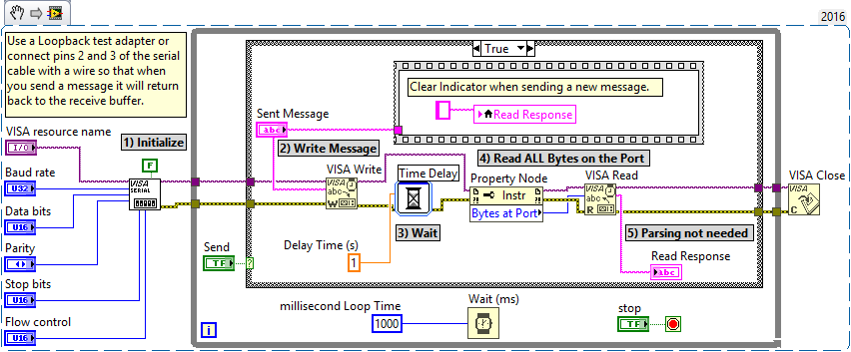
LabVIEW Snippet for a Serial Loopback Test

Slide 17
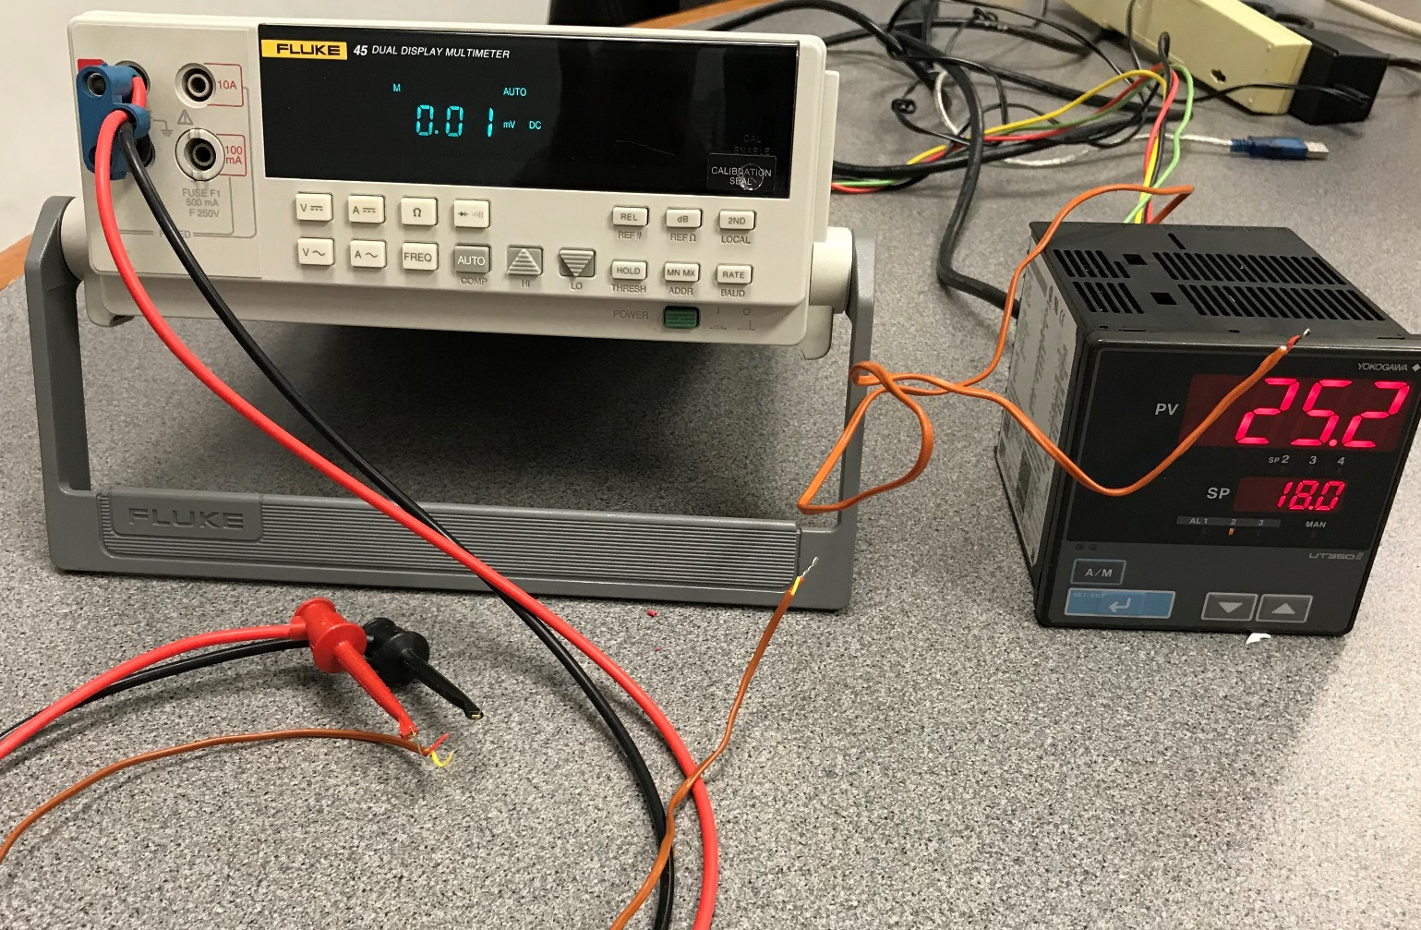
Communicating with a Fluke Multimeter (RS-232) and a Yokogawa PID Controller (RS-485)

Slide 18
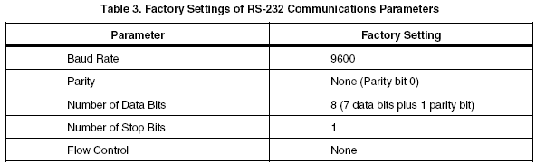
RS-232 Example – Fluke Multimeter
* This comes from the Fluke 45 Multimeter User Manual
Sometimes you can adjust these parameters using the instrument’s command set.

Slide 19
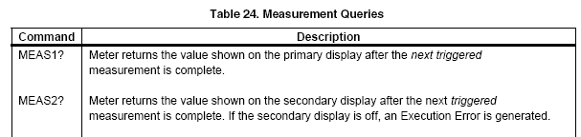
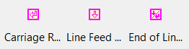
RS-232 Example – Fluke Multimeter
* This comes from the Fluke 45 Multimeter User Manual
The device returns the measurement when the proper command is sent. The correct line terminator must also be used (One of these) ->
A string is returned that must be parsed to obtain the value of the measurement.

Slide 20
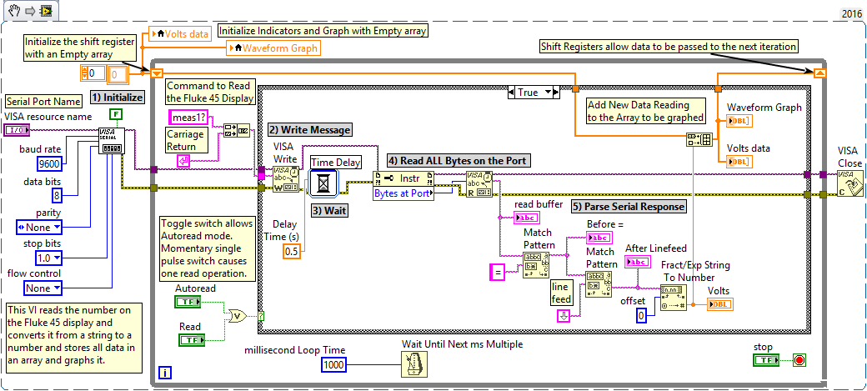
LabVIEW Snippet for a Fluke Multimeter Serial Communication

Slide 21
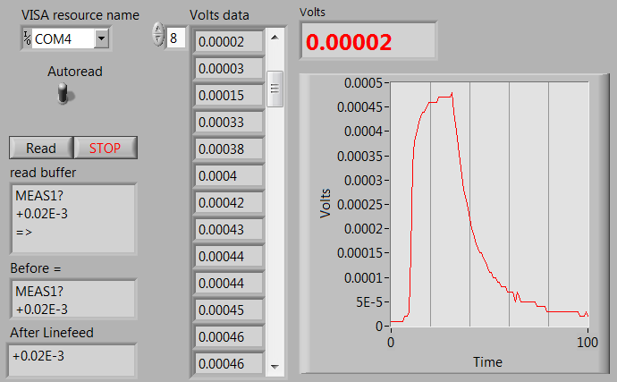
LabVIEW Front Panel for a Fluke Multimeter Serial Communication

Slide 22
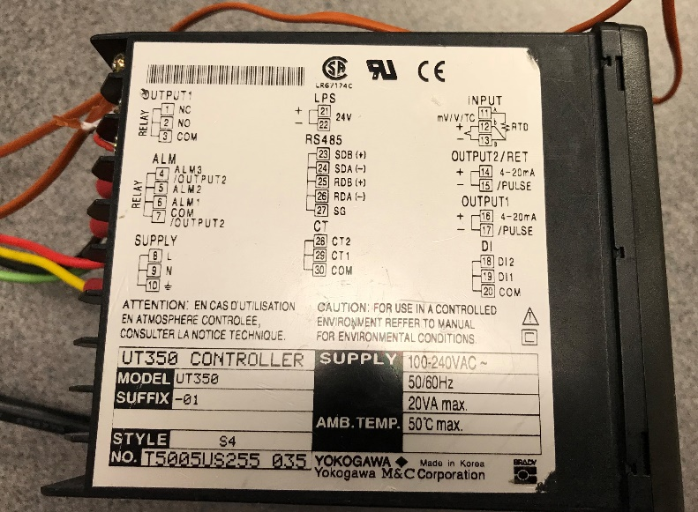
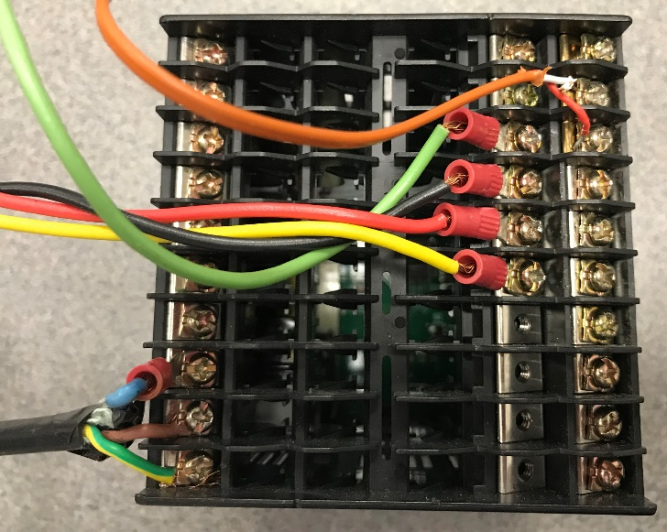
Connecting a Yokogawa PID Controller
J-Type Thermocouple
TD(A)
TD(B)
RD(A)
RD(B)
120 V_{AC} Power Supply

Slide 23
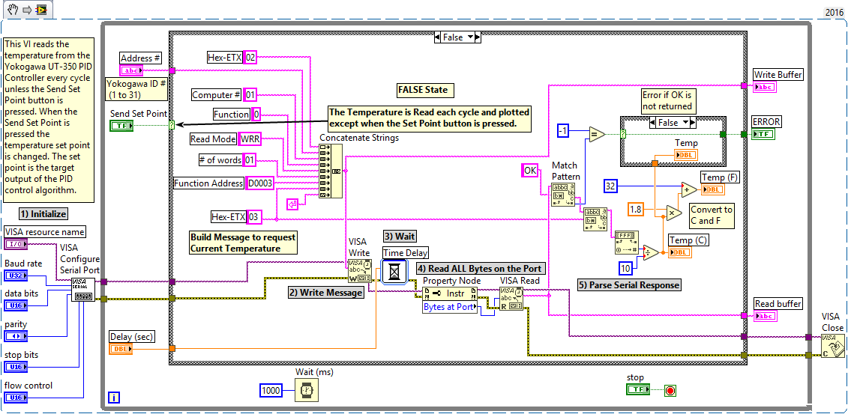
LabVIEW Snippet for a Yokogawa PID Controller Serial Communication

Slide 24
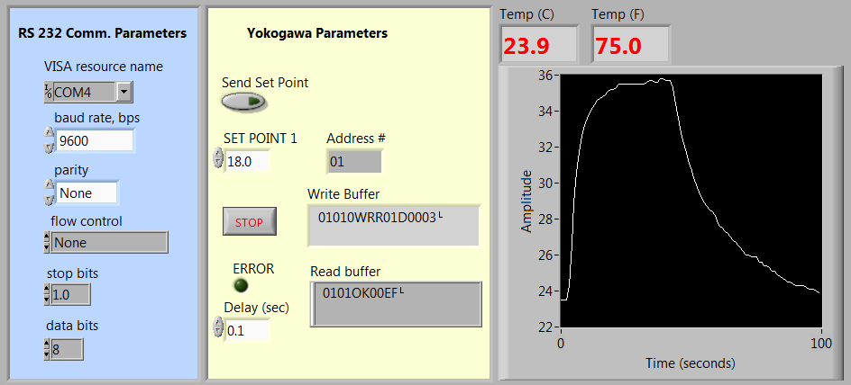
LabVIEW Front Panel for a Yokogawa PID Controller Serial Communication

Slide 25
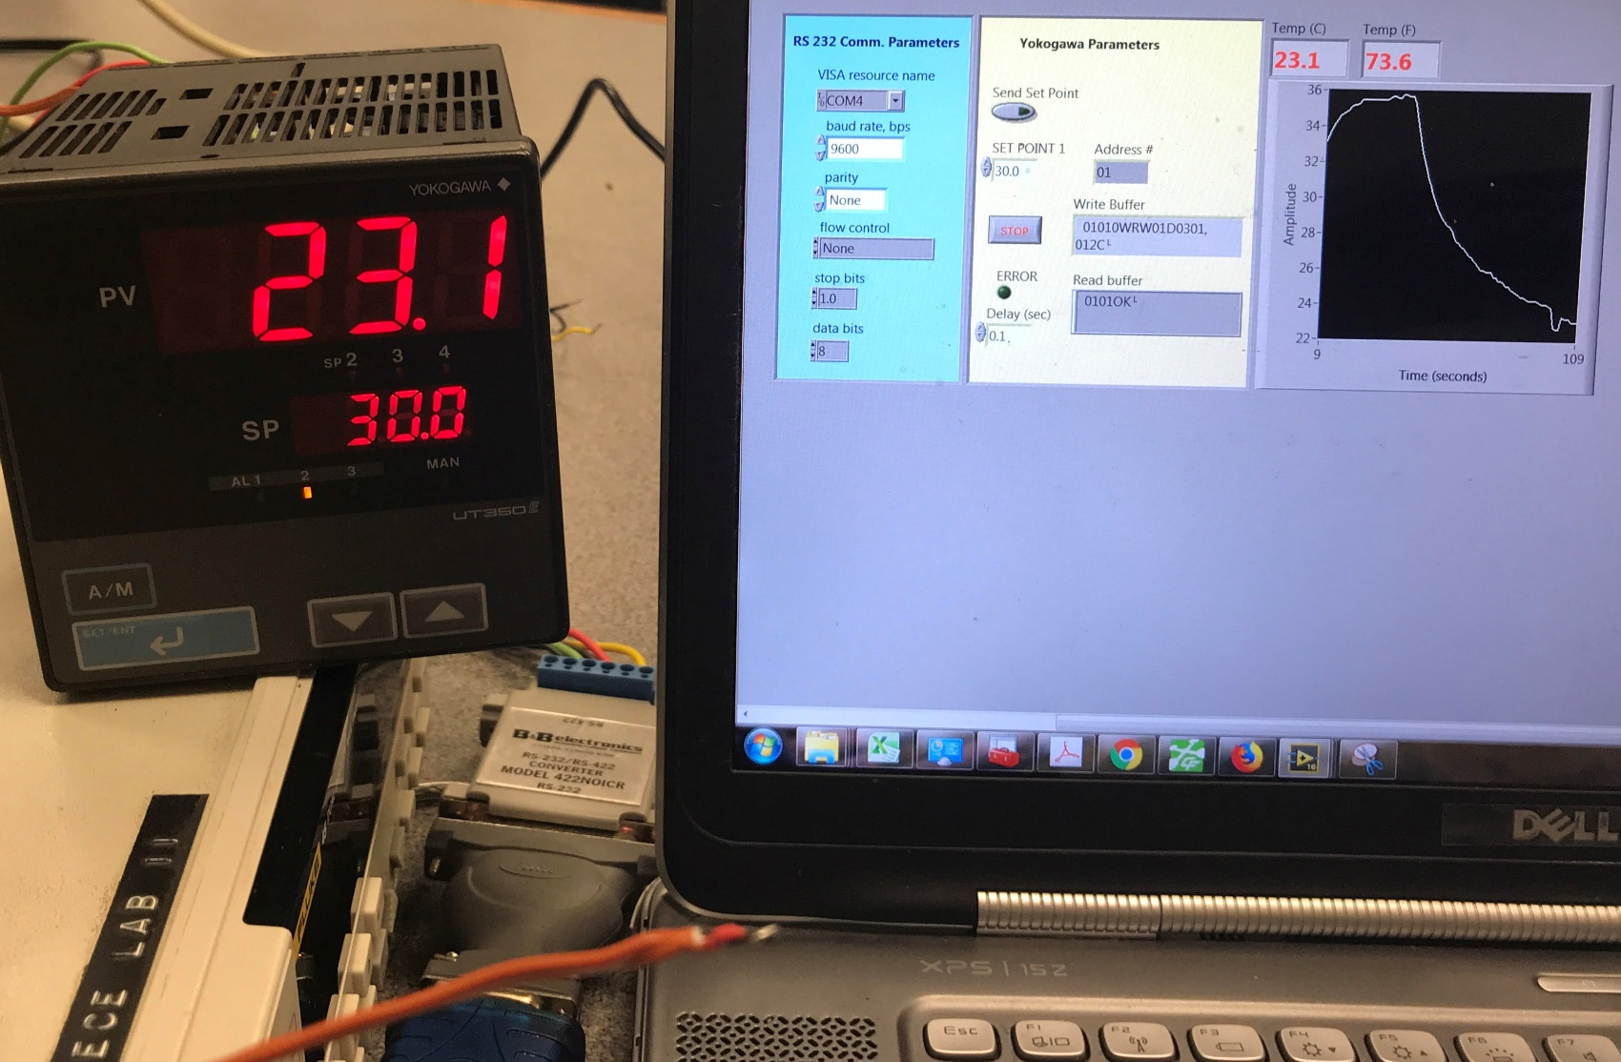
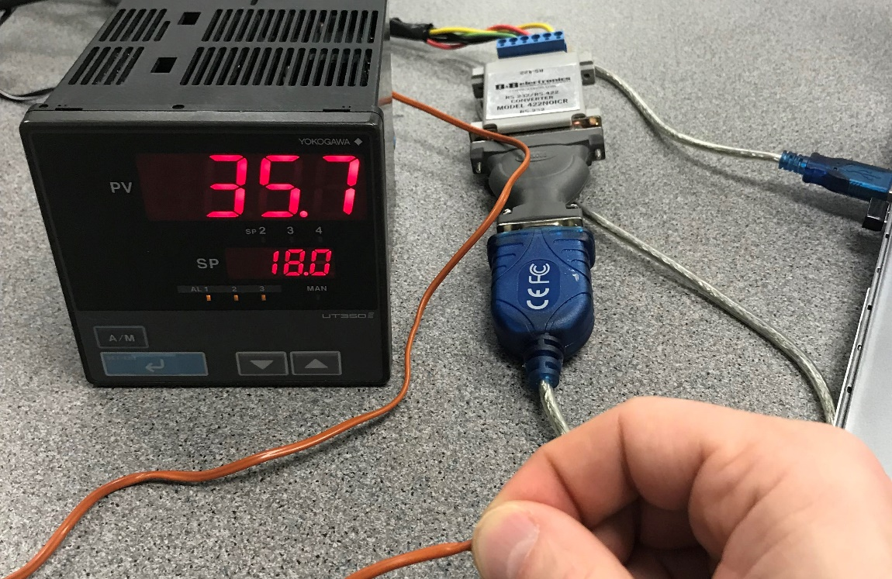
Testing a Yokogawa PID Controller

